Slide 1
Homoscedasticity, Multicollinearity and linearity
DR. SYED HASSAN RAZA

Slide 2
WHAT IS Homoscedasticity?
One of the main assumptions for the ordinary least squares regression is the homogeneity of variance of the residuals. If the model is well-fitted, there should be no pattern to the residuals plotted against the fitted values. If the variance of the residuals is non-constant then the residual variance is said to be “heteroscedastic.” There are graphical and non-graphical methods for detecting heteroscedasticity.

Slide 3
How to check hetroscedasticity?
There are graphical and non-graphical methods for detecting heteroscedasticity. A commonly used graphical method is to plot the residuals versus fitted (predicted) values. We do this by issuing the rvfplot command. Below we use the rvfplot command with the yline(0) option to put a reference line at y=0. We see that the pattern of the data points is getting a little narrower towards the right end, which is an indication of heteroscedasticity.

Slide 4
How to check heteroscedasticity?
rvfplot, yline(0)

Slide 5
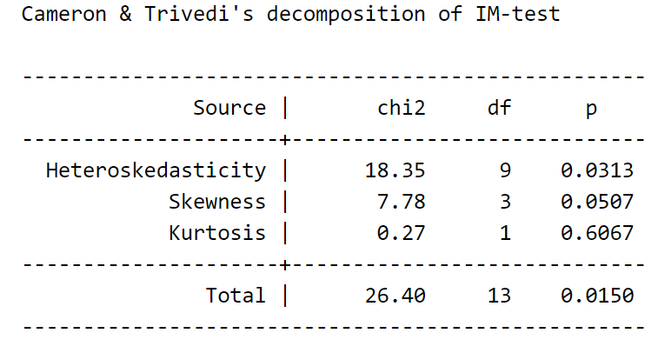
Other commands to test hetroscedasticity
estat imtest

Slide 6
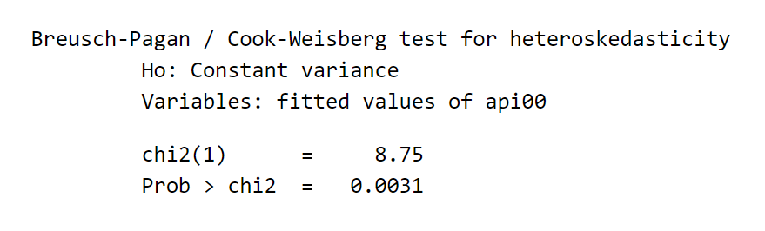
Other commands to test heteroscedasticity
estat hettest

Slide 7
heteroscedasticity
The first test on heteroskedasticity given by imest is the White’s test and the second one given by hettest is the Breusch-Pagan test. Both test the null hypothesis that the variance of the residuals is homogenous. Therefore, if the p-value is very small, we would have to reject the hypothesis and accept the alternative hypothesis that the variance is not homogenous. So in this case, the evidence is against the null hypothesis that the variance is homogeneous. These tests are very sensitive to model assumptions, such as the assumption of normality. Therefore it is a common practice to combine the tests with diagnostic plots to make a judgment on the severity of the heteroscedasticity and to decide if any correction is needed for heteroscedasticity. In our case, the plot above does not show too strong an evidence. So we are not going to get into details on how to correct for heteroscedasticity even though there are methods available.

Slide 8
What is Multicollinearity ?
When there is a perfect linear relationship among the predictors, the estimates for a regression model cannot be uniquely computed. The term collinearity implies that two variables are near perfect linear combinations of one another. When more than two variables are involved it is often called multicollinearity, although the two terms are often used interchangeably.
The primary concern is that as the degree of multicollinearity increases, the regression model estimates of the coefficients become unstable and the standard errors for the coefficients can get wildly inflated. In this section, we will explore some Stata commands that help to detect multicollinearity.

Slide 9
How do we check Multicollinearity ?
We can use the vif command after the regression to check for multicollinearity. vif stands for variance inflation factor. As a rule of thumb, a variable whose VIF values are greater than 10 may merit further investigation. Tolerance, defined as 1/VIF, is used by many researchers to check on the degree of collinearity. A tolerance value lower than 0.1 is comparable to a VIF of 10. It means that the variable could be considered as a linear combination of other independent variables.

Slide 10
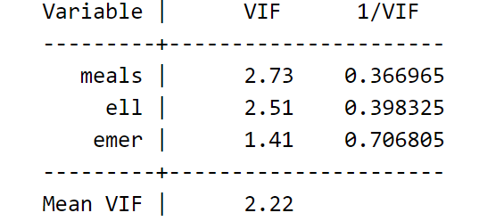
Variance Inflation factor?
Let’s first look at the regression we did from the last section, the regression model predicting api00 from meals, ell and emer and then issue the vif command.
regress api00 meals ell emer (I have omitted the output as we have checked already)
vif
The VIFs look fine here.
Here is an example where the VIFs are more worrisome.

Slide 11
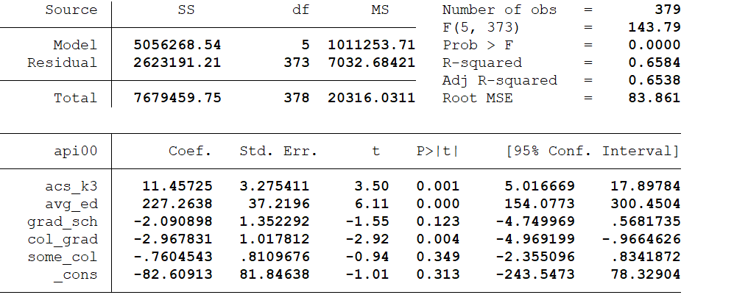
Regression again to check VIF ON NEW SPEC
regress api00 acs_k3 avg_ed grad_sch col_grad some_col

Slide 12
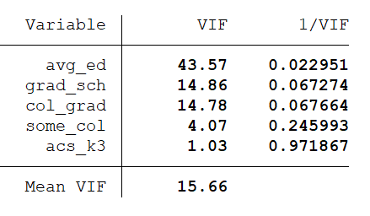
Variance Inflation factor?
vif
In this example, the VIF and tolerance (1/VIF) values for avg_ed grad_sch and col_grad are worrisome. All of these variables measure education of the parents and the very high VIF values indicate that these variables are possibly redundant. For example, after you know grad_sch and col_grad, you probably can predict avg_ed very well. In this example, multicollinearity arises because we have put in too many variables that measure the same thing, parent education.

Slide 13
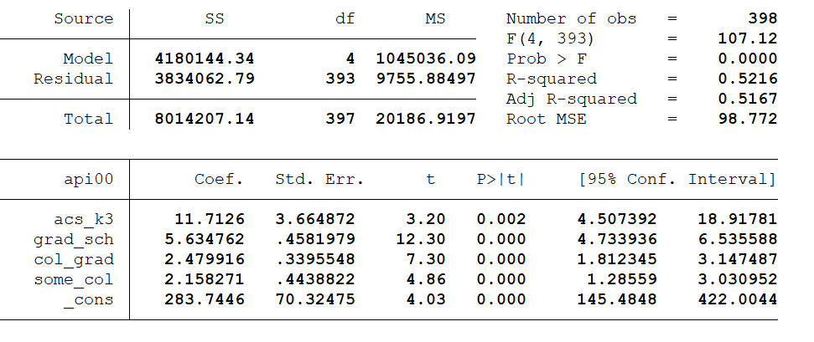
New specification to see the impact on vif
Let’s omit one of the parent education variables, avg_ed. Note that the VIF values in the analysis below appear much better. Also, note how the standard errors are reduced for the parent education variables, grad_sch and col_grad. This is because the high degree of collinearity caused the standard errors to be inflated. With the multicollinearity eliminated, the coefficient for grad_sch, which had been non-significant, is now significant.
regress api00 acs_k3 grad_sch col_grad some_col

Slide 14
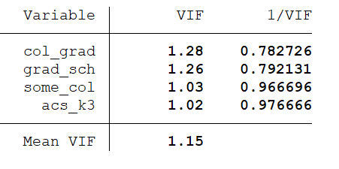
New specification to see the impact on vif
vif

Slide 15
Why do we need Linearity?
When we do linear regression, we assume that the relationship between the response variable and the predictors is linear. This is the assumption of linearity. If this assumption is violated, the linear regression will try to fit a straight line to data that does not follow a straight line.

Slide 16
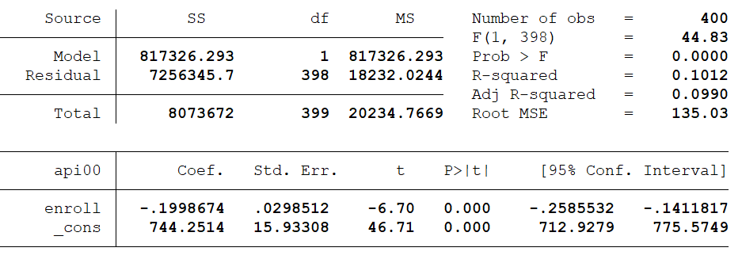
How do we check Linearity?
Checking the linear assumption in the case of simple regression is straightforward, since we only have one predictor. All we have to do is a scatter plot between the response variable and the predictor to see if nonlinearity is present, such as a curved band or a big wave-shaped curve.
use https://stats.idre.ucla.edu/stat/stata/webbooks/reg/elemapi2
regress api00 enroll

Slide 17
How do we check Linearity?
Below we use the scatter command to show a scatterplot predicting api00 from enroll and use lfit to show a linear fit, and then lowess to show a lowess smoother predicting api00 from enroll. We clearly see some degree of nonlinearity.
twoway (scatter api00 enroll) (lfit api00 enroll) (lowess api00 enroll)

Slide 18
Alternative ways to check Linearity?
Checking the linearity assumption is not so straightforward in the case of multiple regression. I will try to illustrate some of the techniques that you can use. The most straightforward thing to do is to plot the standardized residuals against each of the predictor variables in the regression model. If there is a clear nonlinear pattern, there is a problem of nonlinearity. Otherwise, we should see for each of the plots just a random scatter of points. Let’s continue to use dataset elemapi2 here. Let’s use a different model.

Slide 19
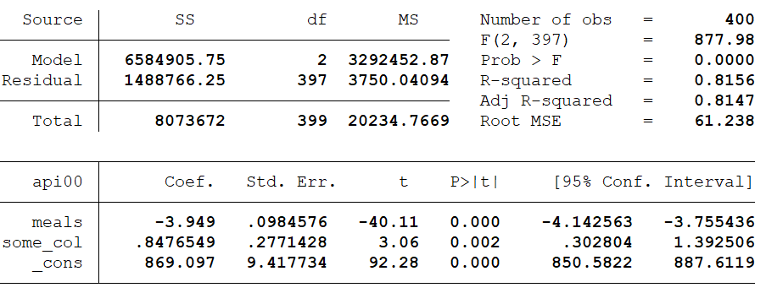
Alternative ways to check Linearity?
regress api00 meals some_col
predict r, resid

Slide 20
Alternative ways to check Linearity?
scatter r meals

Slide 21
Alternative ways to check Linearity?
scatter r some_col

Slide 22
Alternative ways to check Linearity?
The two residual versus predictor variable plots above do not indicate strongly a clear departure from linearity. Another command for detecting non-linearity is acprplot. acprplot graphs an augmented component-plus-residual plot, a.k.a. augmented partial residual plot. It can be used to identify nonlinearities in the data. Let’s use the acprplot command for meals and some_col and use the lowess lsopts(bwidth(1)) options to request lowess smoothing with a bandwidth of 1.
In the first plot below the smoothed line is very close to the ordinary regression line, and the entire pattern seems pretty uniform. The second plot does seem more problematic at the right end. This may come from some potential influential points. Overall, they don’t look too bad and we shouldn’t be too concerned about non-linearities in the data.

Slide 23
Alternative ways to check Linearity?
acprplot meals, lowess lsopts(bwidth(1))

Slide 24
Alternative ways to check Linearity?
acprplot some_col, lowess lsopts(bwidth(1))

Slide 25
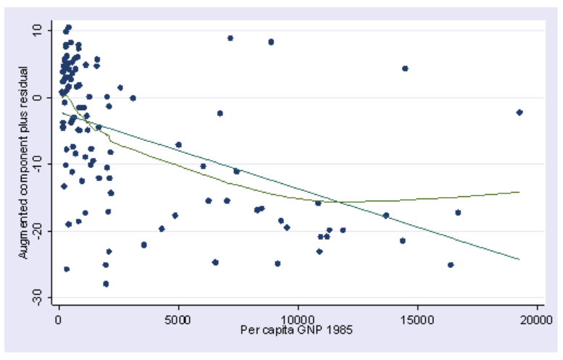
How does non-linearity look like?

Slide 26
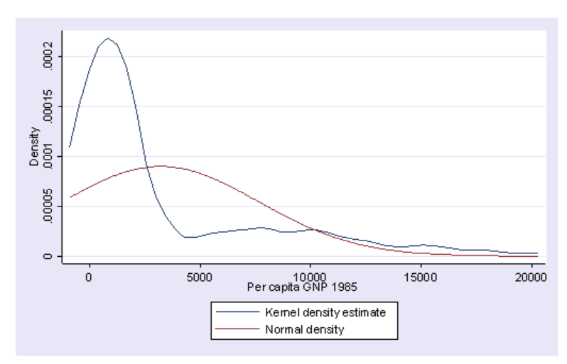
non-normality?
It is very skewed. This suggests to us that some transformation of the variable may be necessary. One of the commonly used transformations is log transformation.

Slide 27
Model Specification
A model specification error can occur when one or more relevant variables are omitted from the model or one or more irrelevant variables are included in the model. If relevant variables are omitted from the model, the common variance they share with included variables may be wrongly attributed to those variables, and the error term is inflated. On the other hand, if irrelevant variables are included in the model, the common variance they share with included variables may be wrongly attributed to them. Model specification errors can substantially affect the estimate of regression coefficients.
Consider the model on the next slide. This regression suggests that as class size increases the academic performance increases. Before we publish results saying that increased class size is associated with higher academic performance, let’s check the model specification.

Slide 28
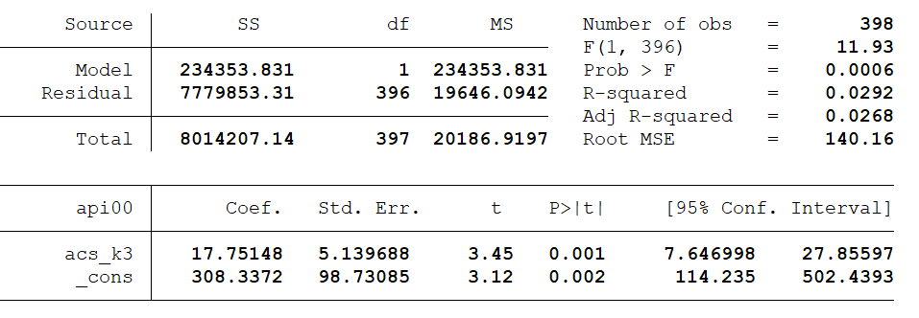
Model Specification
use https://stats.idre.ucla.edu/stat/stata/webbooks/reg/elemapi2
regress api00 acs_k

Slide 29
Model Specification
There are a couple of methods to detect specification errors. The linktest command performs a model specification link test for single-equation models. linktest is based on the idea that if a regression is properly specified, one should not be able to find any additional independent variables that are significant except by chance. linktest creates two new variables, the variable of prediction, _hat, and the variable of squared prediction, _hatsq. The model is then refit using these two variables as predictors. _hat should be significant since it is the predicted value. On the other hand, _hatsq shouldn’t, because if our model is specified correctly, the squared predictions should not have much explanatory power. That is we wouldn’t expect _hatsq to be a significant predictor if our model is specified correctly. So we will be looking at the p-value for _hatsq.

Slide 30
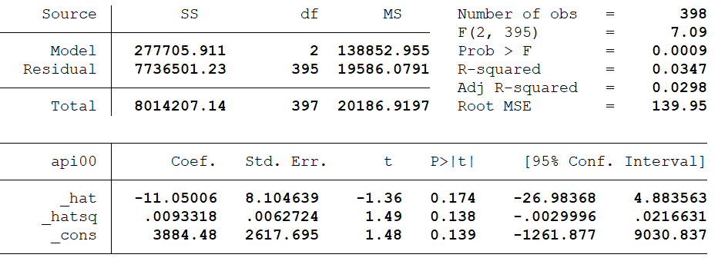
Model Specification
linktest

Slide 31
Model Specification
From the above linktest, the test of _hatsq is not significant. This is to say that linktest has failed to reject the assumption that the model is specified correctly. Therefore, it seems to us that we don’t have a specification error. But now, let’s look at another test before we jump to the conclusion.

Slide 32
Model Specification
The ovtest command performs another test of regression model specification. It performs a regression specification error test (RESET) for omitted variables. The idea behind ovtest is very similar to linktest. It also creates new variables based on the predictors and refits the model using those new variables to see if any of them would be significant. Let’s try ovtest on our model.

Slide 33
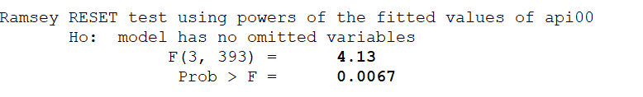
Model Specification
ovtest
The ovtest command indicates that there are omitted variables. So we have tried both the linktest and ovtest, and one of them (ovtest) tells us that we have a specification error. We therefore have to reconsider our model.

Slide 34
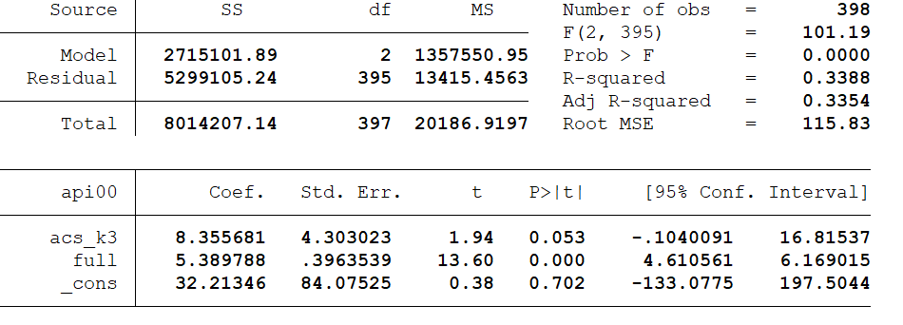
Model Specification
Let’s try adding the variable full to the model. Now, both the linktest and ovtest are significant, indicating we have a specification error.
regress api00 acs_k3 full

Slide 35
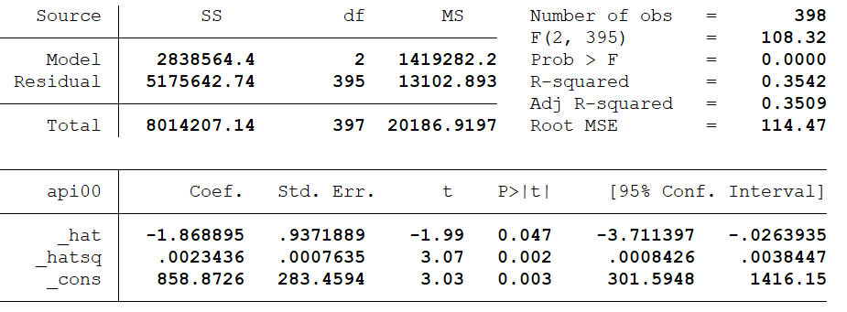
Model Specification
linktest

Slide 36
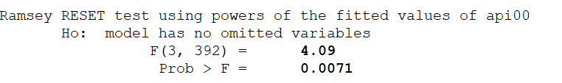
Model Specification
ovtest

Slide 37
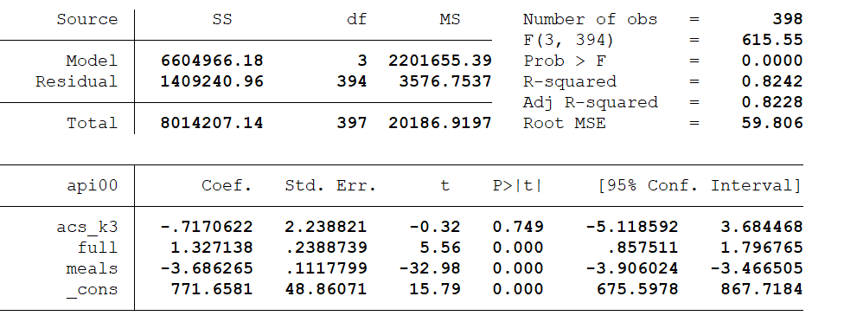
Model Specification
Let’s try adding one more variable, meals, to the above model.
regress api00 acs_k3 full meals

Slide 38
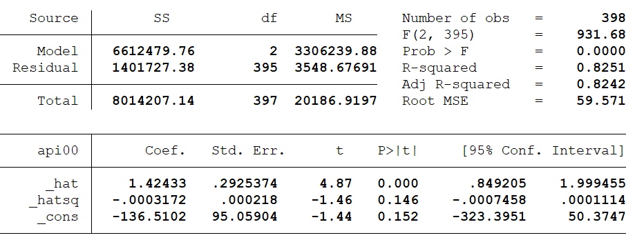
Model Specification
linktest

Slide 39
Model Specification
The linktest is significant while the p-value for ovtest is slightly greater than .05. Note that after including meals and full, the coefficient for class size is no longer significant. While acs_k3 does have a positive relationship with api00 when no other variables are in the model, when we include, and hence control for, other important variables, acs_k3 is no longer significantly related to api00 and its relationship to api00 is no longer positive.
linktest and ovtest are tools available in Stata for checking specification errors, though linktest can actually do more than check omitted variables as we used here, e.g., checking the correctness of link function specification. For more details on those tests, please refer to Stata manual.

Slide 40
Issues of independence
The statement of this assumption that the errors associated with one observation are not correlated with the errors of any other observation cover several different situations. Consider the case of collecting data from students in eight different elementary schools. It is likely that the students within each school will tend to be more like one another than students from different schools, that is, their errors are not independent. We will deal with this type of situation later on if we have time to demonstrate the regress command with cluster option.

Slide 41
Issues of independence
Another way in which the assumption of independence can be broken is when data are collected on the same variables over time. Let’s say that we collect truancy data every semester for 12 years. In this situation it is likely that the errors for observation between adjacent semesters will be more highly correlated than for observations more separated in time. This is known as autocorrelation. When you have data that can be considered to be time-series you should use the dwstat command that performs a Durbin-Watson test for correlated residuals.
We don’t have any time-series data, so we will use the elemapi2 dataset and pretend that snum indicates the time at which the data were collected. We will also need to use the tsset command to let Stata know which variable is the time variable.

Slide 42
Issues of independence
tsset snum
regress api00 enroll
Output omitted as I have shown it already in the previous slides.

Slide 43

Issues of independence
dwstat
The Durbin-Watson statistic has a range from 0 to 4 with a midpoint of 2. The observed value in our example is very small, close to zero, which is not surprising since our data are not truly time-series. A simple visual check would be to plot the residuals versus the time variable.

Slide 44
Issues of independence
The Durbin-Watson statistic will always have a value between 0 and 4. A value of 2.0 means that there is no autocorrelation detected in the sample. Values from 0 to less than 2 indicate positive autocorrelation and values from from 2 to 4 indicate negative autocorrelation.

Slide 45
Issues of independence
predict r, resid
scatter r snum

Slide 46
Thank you for listening to me !!!

